Slide 1
Introduction to Visual Studio 2019
Self-Study

Slide 2
Console (Command Prompt)

Slide 3

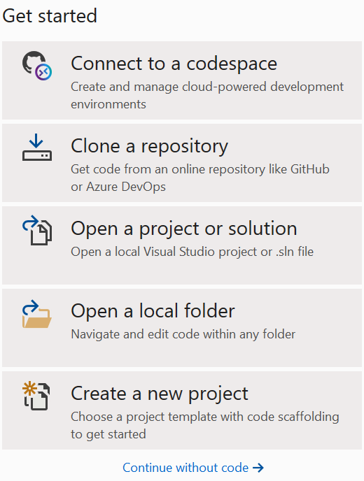

Console / 1..
3
Create a new project
1
Search for Visual Studio 2019 in Windows 10
2
Launch the Application

Slide 4
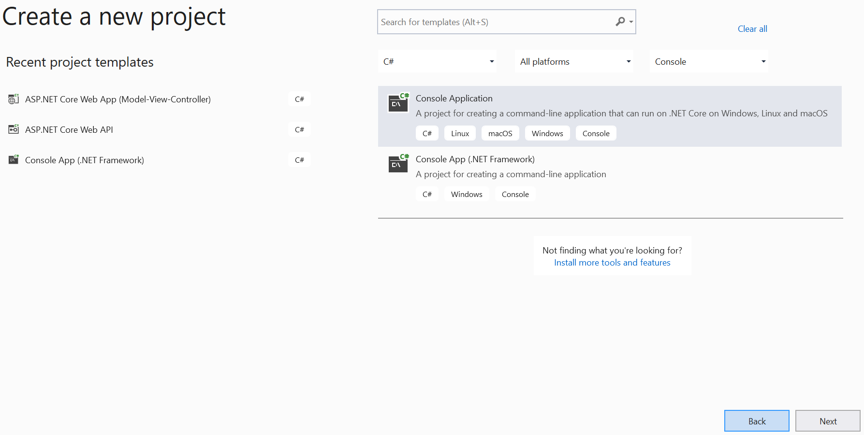
Console / 2..
Choose Console Application and click Next

Slide 5
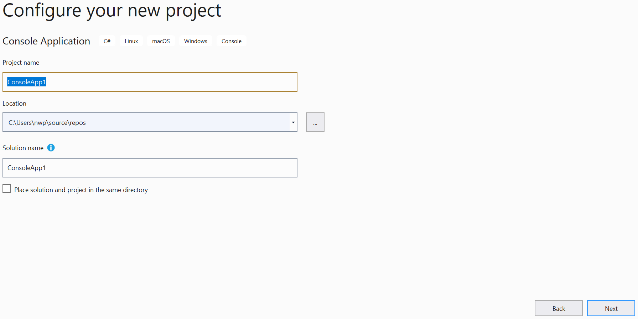
Console / 3..
Type the Project name and appropriate Location and click Next

Slide 6
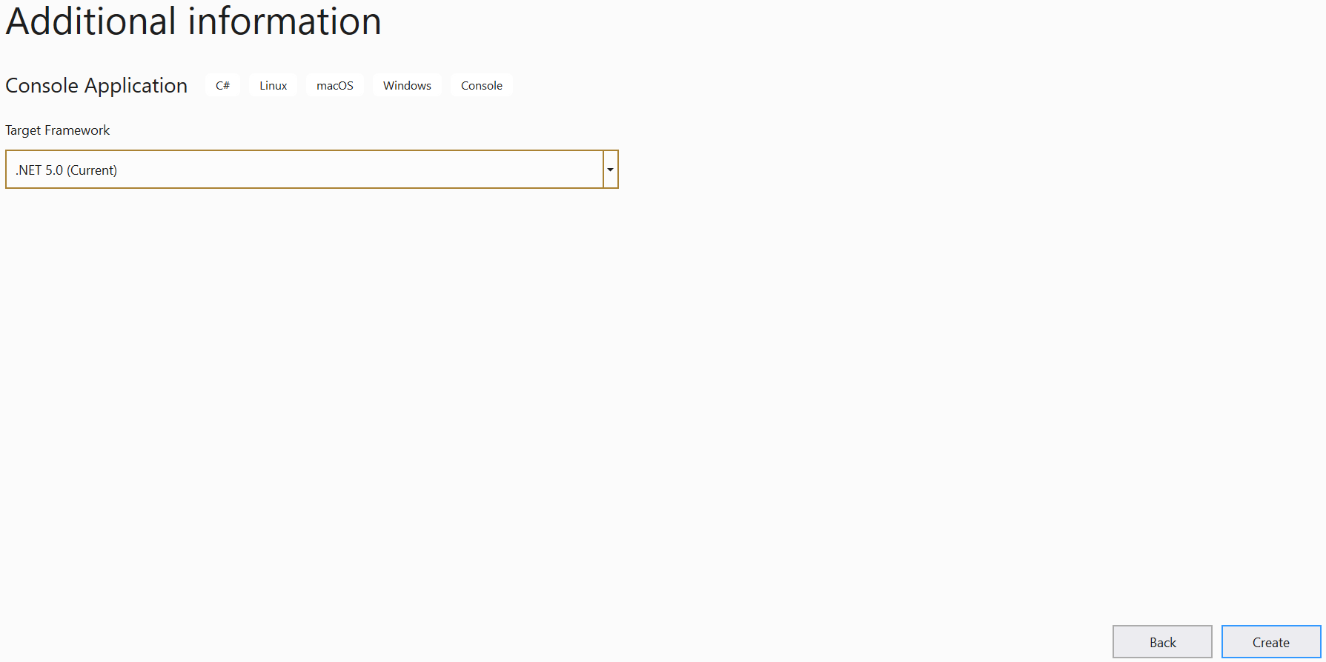
Console / 4..
Choose .NET 5.0 (Current) and click Create

Slide 7
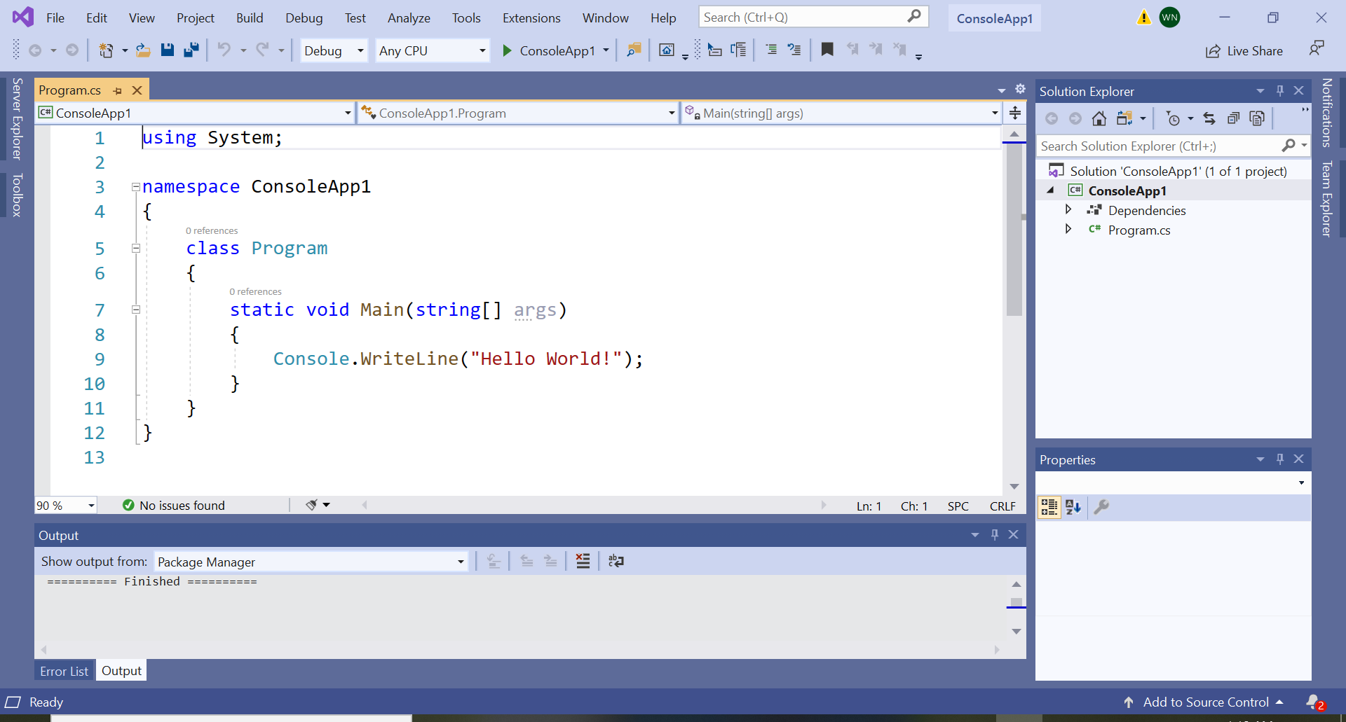
Console / 5..
1
Menu
5
Run or F5
2
Working Space (Code)
3
Solution Explorer
4
Properties Pane

Slide 8
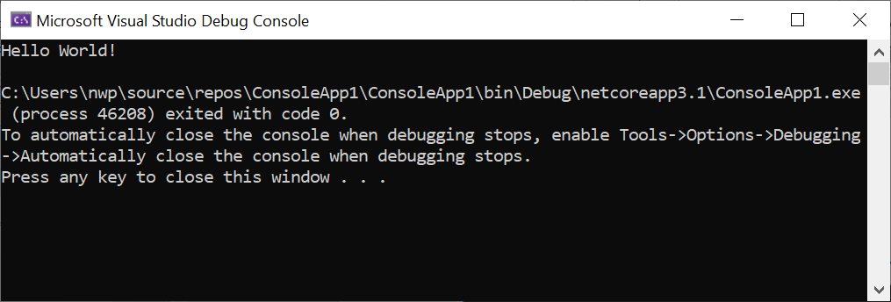
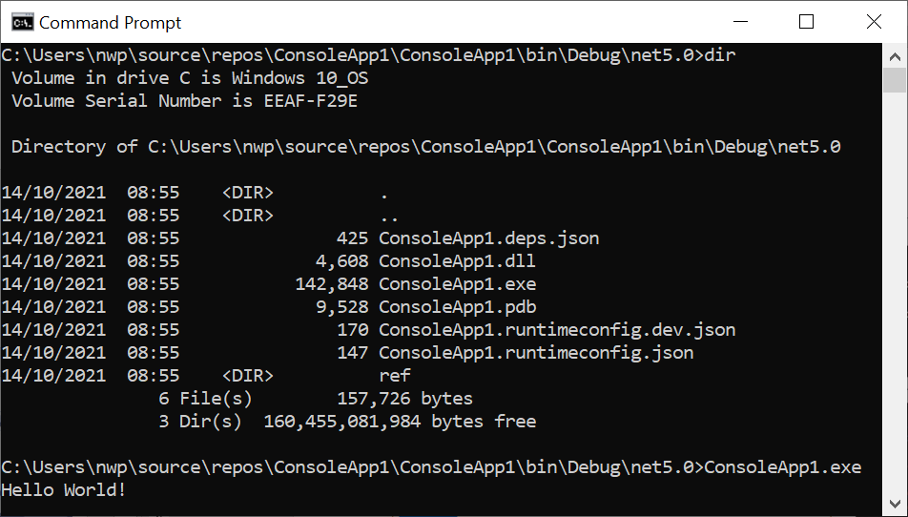
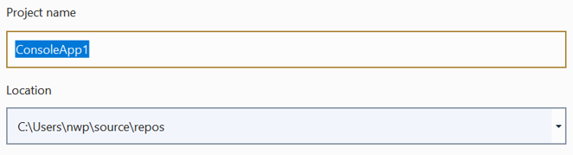
Console / ..6
1
Result after a Run (F5) is executed
2
Actual location of Executable Program

